Slide 1

DATA VISUALIZATION
START: DECEMBER 9, 2021
END: JANUARY 1, 2022
INSTRUCTOR: MEDIA ELMAS

Slide 2

Agenda
Schedule
Goal
Data Literacy
Data Visualization
Chart Types
Tableau

Slide 3
Schedule
Tableau
PowerBI
Thu, 12/9/2021 – Chart Types
Sat, 12/11/2021 – Hands on Practice
Tue, 12/14/2021 – Projects
Thu, 12/16/2021 – Data Storytelling
Sat, 12/18/2021 – Projects and Server
Tue, 12/21/2021 – Starting PowerBI
Thu, 12/23/2021 – Projects
Sat, 12/25/2021 – No Class
Tue, 12/28/2021 – Presentation
Thu, 12/30/2021 – Group Project
Sat, 01/01/2022 – No Class

Slide 4
Goals
Understand
Experience
Troubleshoot
Story - Telling
Credibility
Understand the importance of data literacy and how to use the correct chart type
Gain experience with the high demand data visualization tools
Indicate issues and how to troubleshoot
Become a great data storyteller
Have 4 to 5 solid dashboards to have on your resume talk to interviewers about

Slide 5
Data Literacy
The ability to explore, understand, and communicate with data
Solving a problem
Snowball effect with asking a question after question
The key to successful data exploration is producing good questions
Notes:
If the idea of data literacy makes you nervous, think about times you have successfully solved problems.
Have you ever wanted to:
Recreate a favorite meal without having a recipe?
Figure out whether adopting a certain pet would be a good fit for your lifestyle?
Understand how to care for a loved one who was feeling ill?
What did you do?
You started with a question
then used a variety of methods to collect facts to help you answer that question.
You may have noticed that answering one question led to additional questions and the need for additional facts.
Once you answered all your questions, you probably implemented the answers in a solution and communicated that solution with others.

Slide 6
Example
You love dogs and care about health.
Which question will help direct you to knowing what data to use?
Q1 - Is owning a dog good for one's health?
Q2 - How do dog owners and non-dog owners compare in health outcomes among people with chronic illnesses in the United States?
Notes:
The first question is broad; there's no clear criteria for what counts as "good."
The second question is much more specific. It uses clearly defined terms and narrows its focus to a specific population.
You could easily explore data to answer the second question than the first.

Slide 7






Elements to a Great Analyst
Interest - genuinely passionate about a topic
Curiosity - wonder how things work
Imagination- come up with new things to try
Self-motivation - go beyond the scope of what's expected without waiting to be told what to do
Open-mindedness and flexibility - willing to accept what you find and willing to admit when you’re wrong
Awareness of what's worthwhile - know how to prioritize questions in order to see the difference between a worthwhile pursuit versus spending a lot if time and get few results
Pattern spotting - spot patterns that are meaningful and ignore ones that are not
Healthy skepticism - even when you're confident about an answer or a result, look at it from a different perspective to possibly learn something new
Ability to analyze and ability to synthesize – be able to examine something complex, and recognize its many parts and how these parts interact to form a whole
Familiarity with the data - make sure you become familiar with the facts so you don't jump to conclusions that may be inaccurate
Notes:
Skill in the practices of data analysis
The skills of data analysis can be developed through training, experience, and lots of practice.

Slide 8
Data is comprised of values of qualitative or quantitative variables, belonging to a set of items
Set of items - the group of objects you are interested in (e.g. population)
Variable - a measurement, property, or characteristic of an item that may vary or change
Qualitative variable - describes qualities or characteristics, such as country of origin, gender, name, or hair color
Quantitative variable - addresses measurable characteristics, such as height, weight, or temperature

Slide 9
Test your knowledge
Determine whether each characteristic is a qualitative variable or a quantitative variable
Political party
Calories
Flavor
Species
Make of Car
Vote count
Price
Population count

Slide 10
Answers
Political party – Qualitative
Calories - Quantitative
Flavor - Qualitative
Species – Qualitative
Make of Car – Qualitative
Vote count – Quantitative
Price – Quantitative
Population count – Quantitative

Slide 11


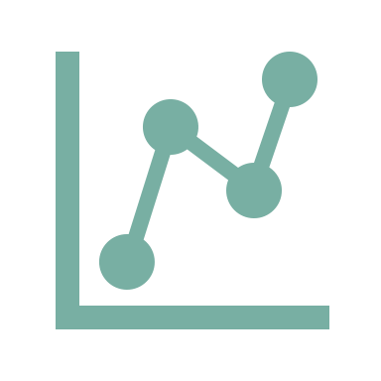

Data Visualization
Turning data into charts and graphs to help tell a story
Makes it easier to understand what is happening in the business
Helps to identify outliers, trends, and patterns to make data-driven decisions
Used in reports and interactive dashboard

Slide 12
Types of Data Visualizations
Charts
Graphs
Tables
Maps
Dashboards

Slide 13
Types of Data Visualizations
Charts
Graphs
Tables
Maps
Dashboards

Slide 14

Charts VS Graphs
Charts
Graphs
Represents information that can be in the form of a diagram, table, or graph Best presenting large information
Type of chart used to show the mathematical relationship between different sets of data by plotting on it’s Horizontal (X-axis) and Vertical (Y-axis). Best to show trend or relation between 2 or more variables

Slide 15
Chart and Graph Types
Comparison
Composition
Bar Chart
Column Chart
Line Chart
Stacked Column Chart
Pie Chart
Relationship
Distribution
Bubble Chart
Scatter Chart
Histogram Chart
Box and Whisker Chart

Slide 16
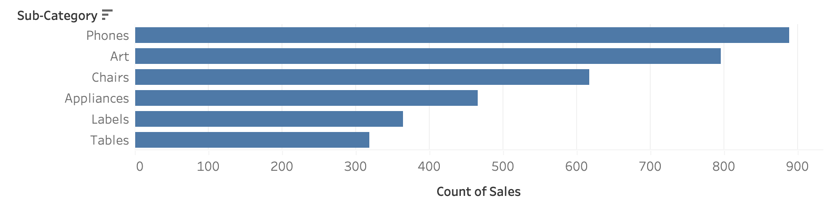
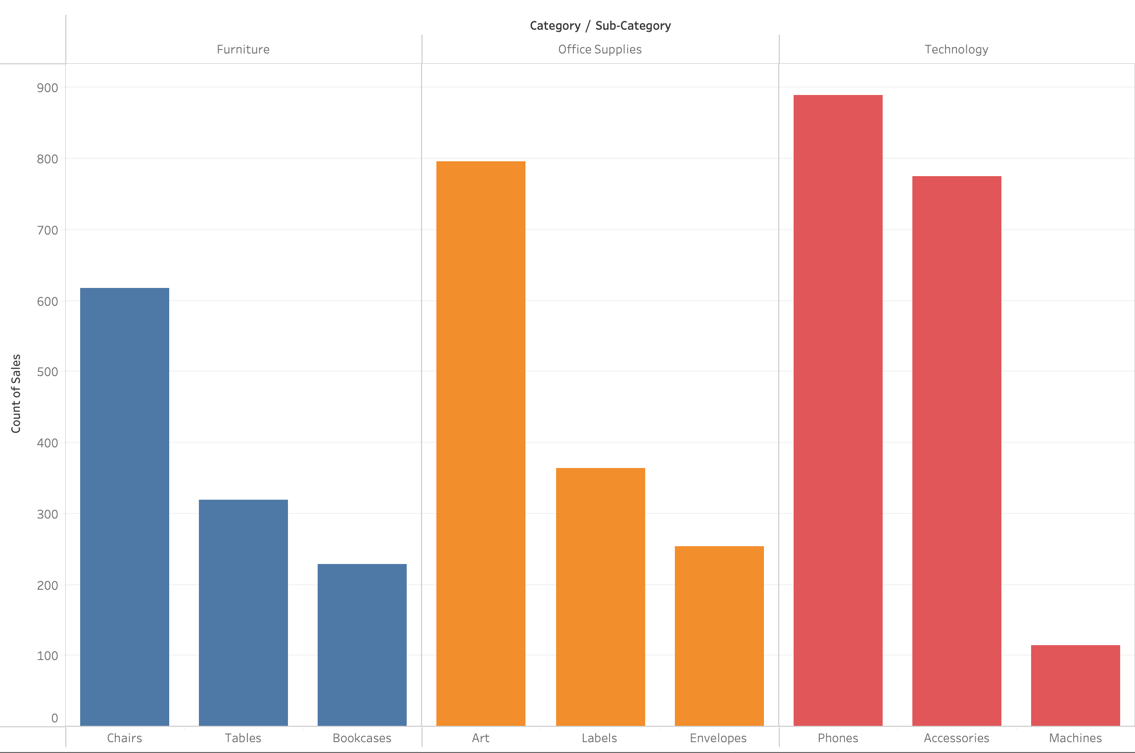
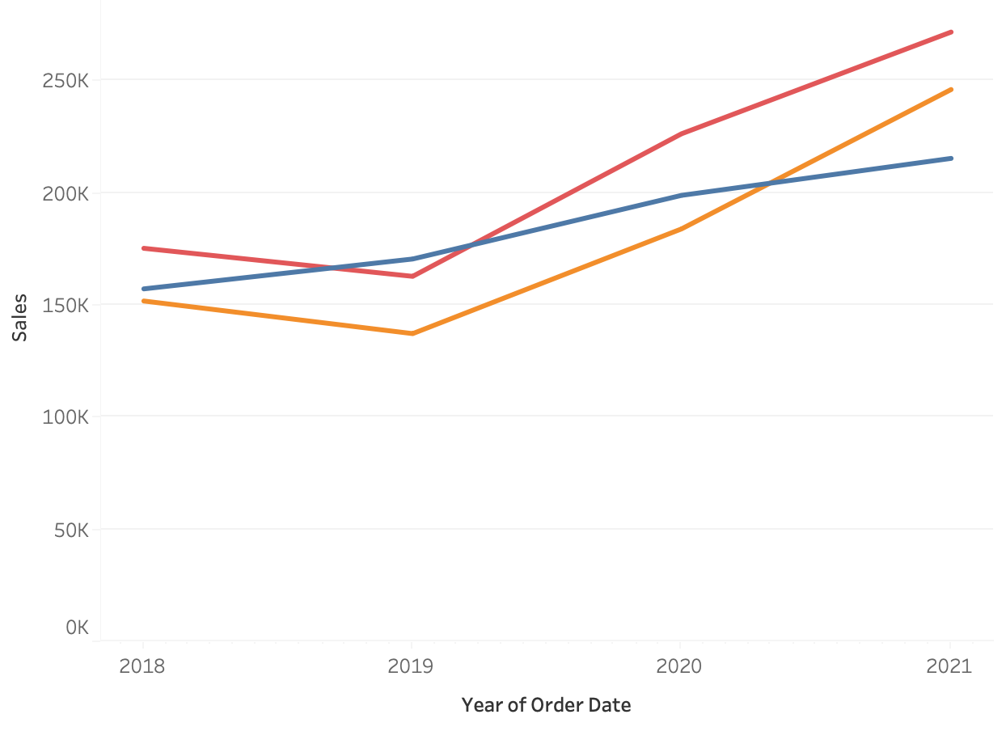
Chart Types – Comparison
Bar Chart
2 or more category/variable(s)
1 or more measure(s)
Column Chart
2 or more category/variables
1 or more sub variable(s)
1 or more measure(s)
Line Chart
1 or more category/variable(s)
Trend over time
1 or more measure(s)

Slide 17
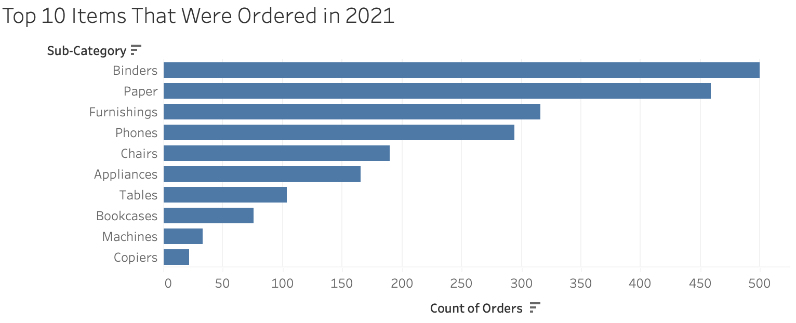
Bar Chart - shows a comparison of different values in subcategories.
A good bar chart rules:
The base starts at zero
The axes are labeled clearly
Colors are consistent and defined
The bar chart does not display too many bars
What not to do:
Make each bar a different width
Cram too many bars into subcategories
Leave the axes unlabeled
Notes:
Bar charts show a comparison of different values in subcategories. For example, bar charts can show how much money a small business spends by expense type. They can also show how many different items each department sold within a store across a consistent interval of time.

Slide 18


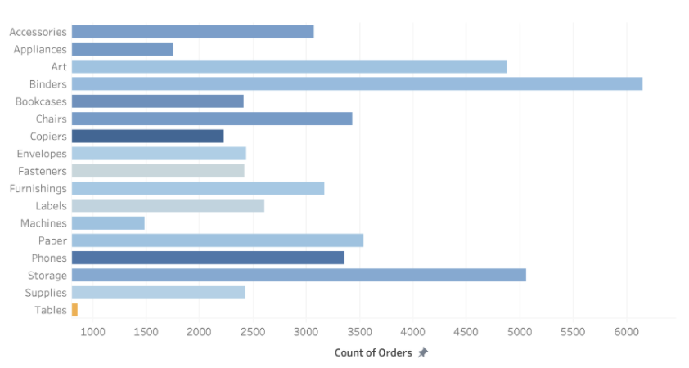
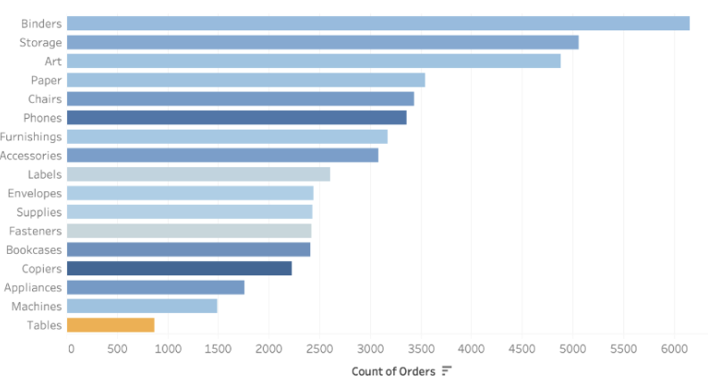
Bar chart example
Poor Example
Better Example
The axis doesn’t start at zero
The bars aren’t sorted
Users could be easily misled because the vertical axis’ starting position
The axis starts at zero prevents confusion by starting at a universally understood baseline
The sorted bars make it easy to identify rank within Subcategories

Slide 19
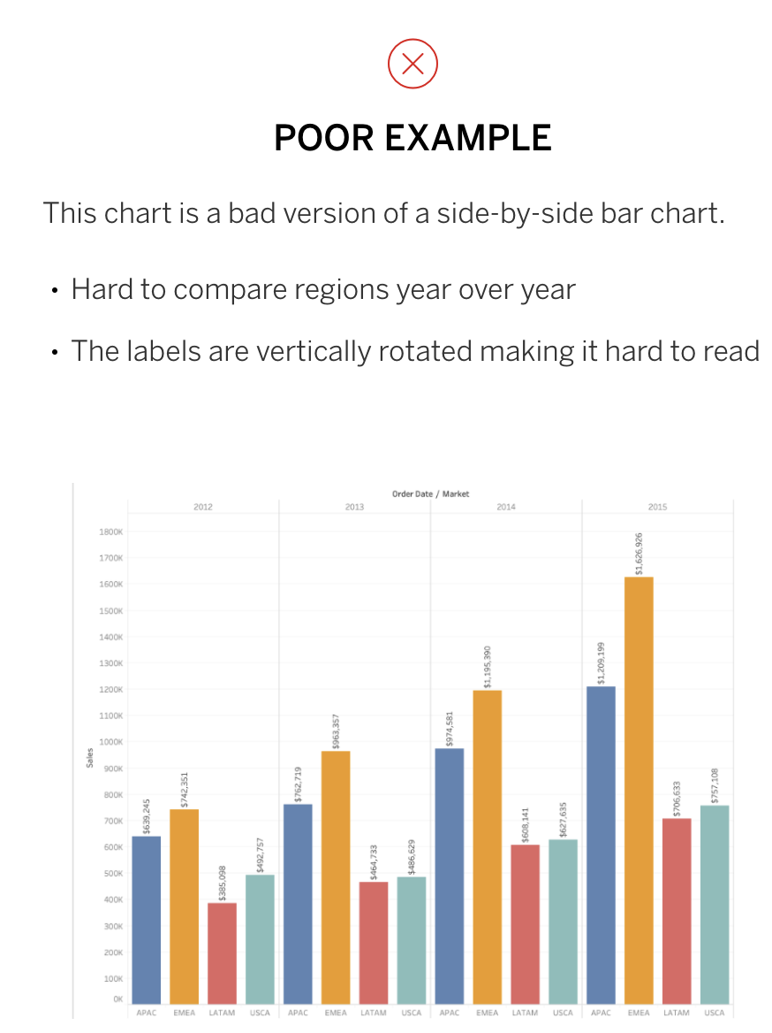
Column Chart - shows a comparison of different values in subcategories.
Poor Example
Better Example
Hard to compare regions year over year
The labels are vertically rotated making it hard to read
Too many colors and not sorted
Categories are organized by color
Subcategories are sorted from most sales to least
Not too many dimensions compared

Slide 20
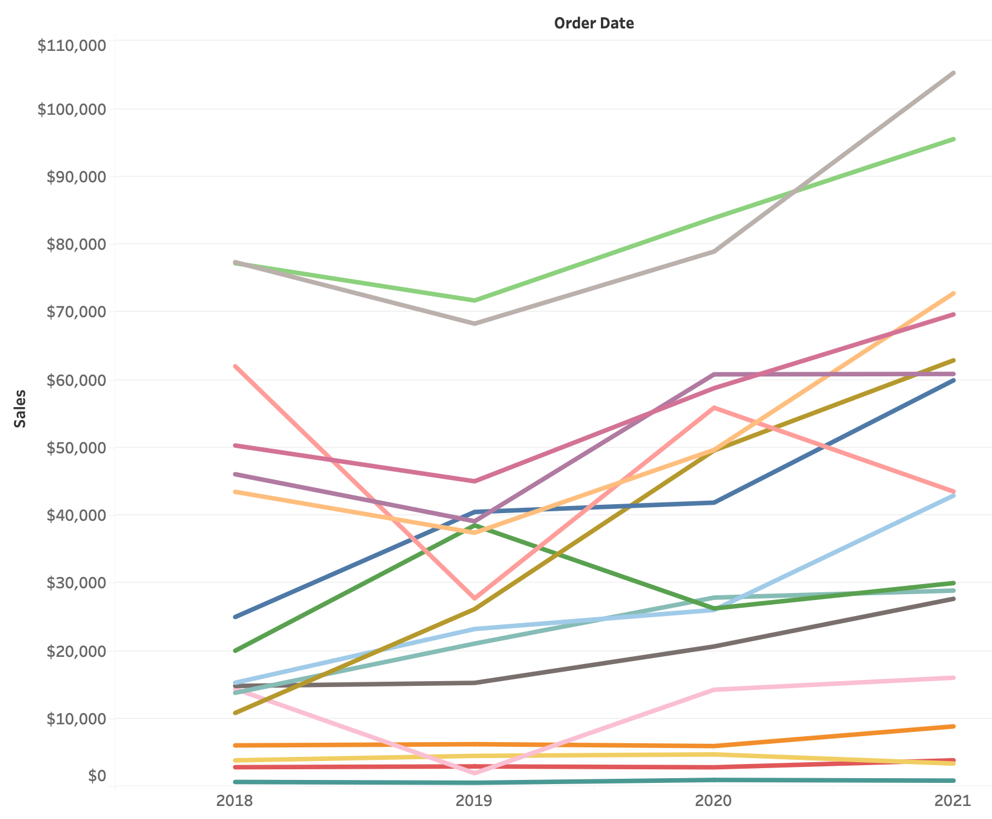
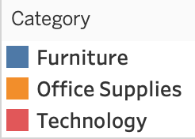
Line Chart - shows trends across time intervals. Multiple lines can be used to compare categories within a dimension.
Poor Example
Better Example
This chart has too many lines
The lines and colors are too similar for the viewer to distinguish
This line graph shows the trend of sales per category from 2018 - 2021
The x-axis represents the date field (Year)
The y-axis represents the quantitative field (Sales)
Notes:
The horizontal line should focus on a measurement with regularly occurring intervals.
Usually, the horizontal line defines a length of time, but it can also focus on another form of measurement as well, so long as it meets the requirements
Use color to identify deviations from the average or a target goal or to define individual members within a measured category.
If you have outliers in your data set, the use of color can be a good way to make them stand out.
Additionally, line charts do not require a zero baseline.
This means it can be included or excluded depending on what the creator of the chart believes best tells the story within the data.
The goal of an effective line chart is to emphasize changes and direction in your data, not display the size of the values themselves.
If there are too many lines or colors on a chart, the visualization becomes confusing and difficult to read.

Slide 21
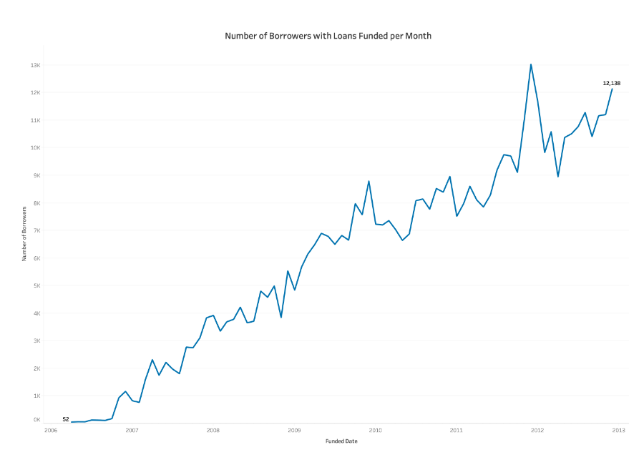
Line Chart
This line chart follows the number of borrowers measured every month over the course of several years.
The x-axis represents the date field
The y-axis represents the quantitative field
The first and last points are labeled for context
Labels for each data point are not displayed to reduce clutter
Axis and light grid lines are visible to the viewer to help in identifying locations of data points
Notes:
When deciding what chart type to use, remember that line charts can help users answer questions like the following:
What patterns appear in the data over time?
Is the data in an upward trend or a downward trend?
Is one category performing better than other sets of data?
Are we likely to meet our quarterly goal?
Consider the stock market as another example. They often use line charts to support buying and selling decisions.
Line charts can show the change in values for a particular stock at different intervals of time, from yearly to minute-by-minute.
Even though the market is somewhat unpredictable, brokers are able to use line charts to help make determinations.
They can see whether a stock is likely to continue on an upward or downward trend.
Their ability to predict what will happen is aided, in part, by the human ability to infer directionality from the lines in the chart.
This makes this chart type a powerful tool for identifying patterns and trends.

Slide 22
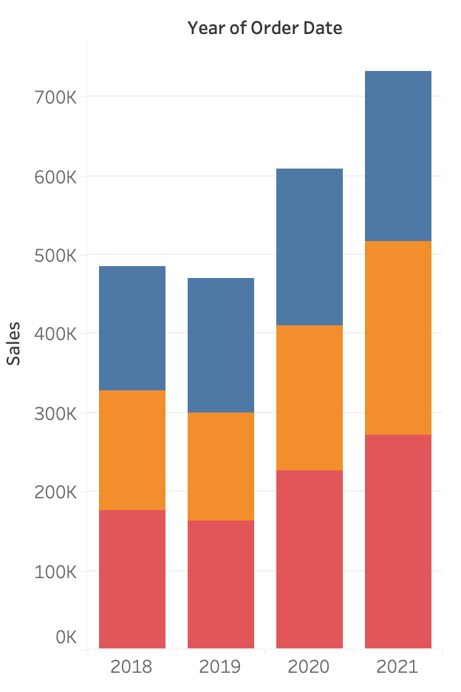
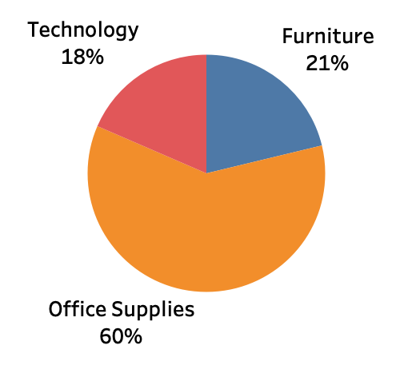
Chart Types – Composition
Pie Chart
2 or more category/variables
1 or 2 measure(s)
Stacked Column Chart
2 or more category/variables
1 or more measure(s)

Slide 23
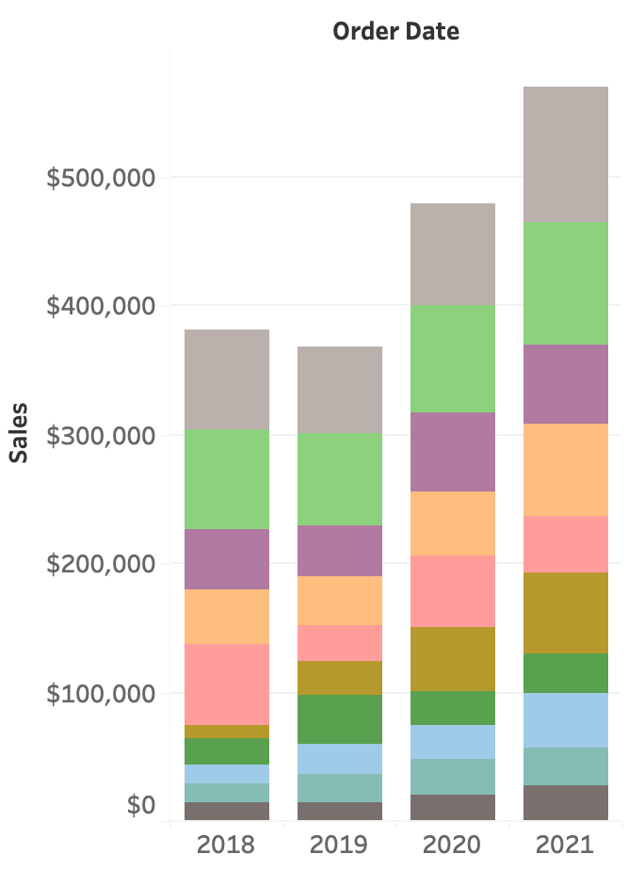
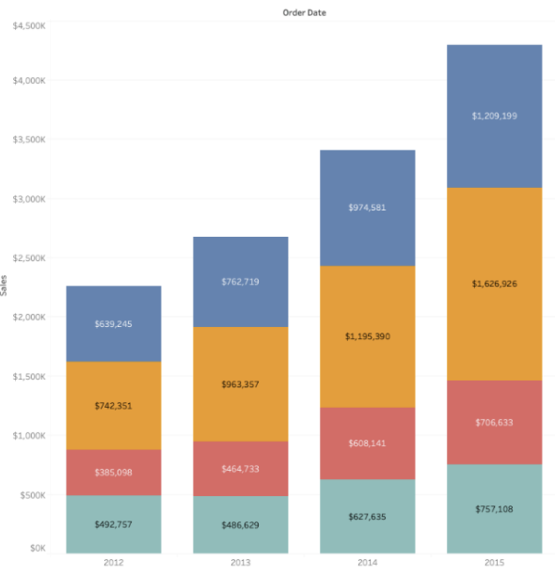
Stacked Bar Chart - shows extra detail within the overall measure
Poor Example
Better Example
Too many colors and variables
No labels of the measures
Variables are too close in measures
View of the total per region is possible
Distinct color per region is used
Each bar is clearly labeled and easy to read
Notes:
A stacked bar chart can show extra detail within the overall measure.
Stacked bar charts can also display parts of a whole through percentages.
When the parts of the whole equal 100 percent of the total, users can better grasp the comparisons between categories.
Take an office supplies store as an example.
Different colored blocks in a bar representing revenue can represent types of sales opportunities.
A red block might represent the contribution from office furniture while a yellow block might represent computer supplies.

Slide 24
Pie Chart - helps organize and show data as a percentage of a whole
Use a pie chart if:
You have a total number that can be split up into 2-5 categories
One category outweighs the other by a significant margin
Pie Chart Best Practices:
Label each pie appropriately, with the right number or percentage attached to the corresponding slice
Ordered the slice by size
make the comparison of slices easy for the user
When the chart has more than 5 slices you may want to begin considering a different chart type
Do not use a pie chart if:
Your dimension has too many categories
Similar percentages/numbers exist between different values within the chosen dimension
Data doesn’t represent a uniform “whole”, or the percentages don’t measure to 100 percent
There are negative values or complex fractions in your measure value
Notes:
A pie chart helps organize and show data as a percentage of a whole.
True to the name, this kind of visualization uses a circle to represent the whole, and slices of that circle, or “pie”, to represent the specific categories that compose the whole.
This type of chart helps the user compare the relationship between different dimensions (Ex. categories, products, individuals, countries, etc.) within a specific context.
Usually, the chart splits the numerical data (measure) into percentages of the total sum.
Each slice represents the proportion of the value, and should be measured accordingly.

Slide 25
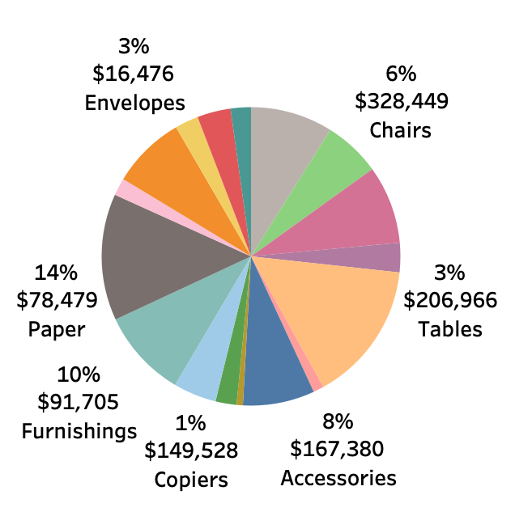
Pie Chart - shows how a few dimensions compare to one another and the whole
Poor Example
Better Example
Too many slices clutter the chart
Slices show similar values labels don’t align with the slices
The same color is used twice
Categories are organized by color
Clear percentage label
Not too many dimensions compared
Notes:
How do I read a Pie Chart?
To read a pie chart, you must consider the area, arc length, and angle of every slice.
Because it can be hard to compare the slices, meaningful organization is key.
Slices in a pie chart should be organized in a coherent way, usually the biggest to smallest, to make it easier for the user to interpret.
Start at the biggest piece and work your way down to the smallest to properly digest the data.
The colors of the slices should match their respective blocks in the legend, so that viewers do not need to consult the legend as much.
Generally, the whole (or total of the quantitative values or slices) is not listed within the pie chart.
Typically, it can be listed in the text near the chart, the table explaining specific data measurements, or as a separate BAN in another dashboard.

Slide 26
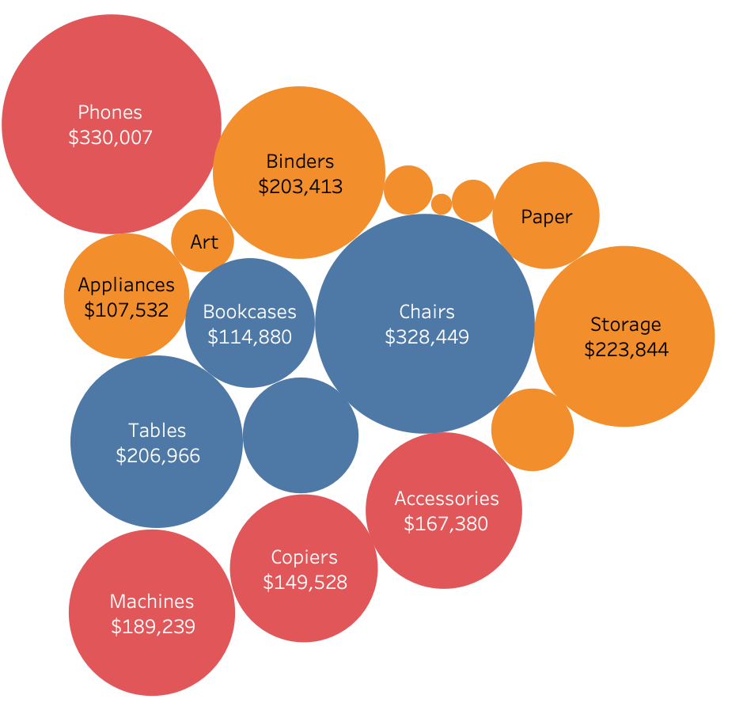
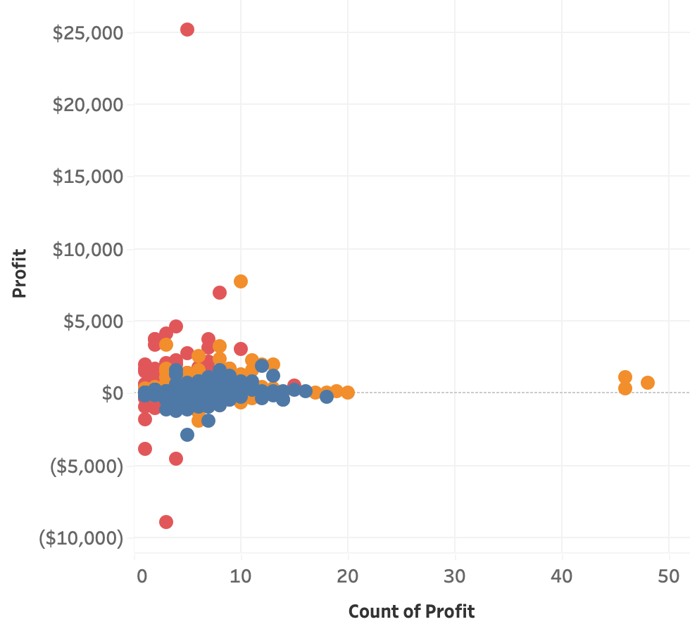
Chart Types – Relationship
Bubble chart
3 or more categories/variables
1 or 2 measure(s)
Scatter Plot
0 to more categories/variables
2 to 4 measures

Slide 27
Scatter Plot - used to investigate the relationship between different variables
Showing if one variable is a good predictor of another
Lots of distinct data points on a single chart
Great to identify outliers too
The scatter plot shows the count of items sold and how much profit was made
Color displays different categories
Each point represents the brand of the product being sold
You can tell which technology brand is most profitable and not
Lower count higher $
Higher count and less $
Notes:
Scatter plots are an effective way to investigate the relationship between different variables, showing if one variable is a good predictor of another, or if they tend to change independently.
A scatter plot presents lots of distinct data points on a single chart. The chart can then be enhanced with analytics like cluster analysis or trend lines.

Slide 28
Bubble Chart - shows the relationship between three or more measures
Showing if one variable is a good predictor of another
Lots of distinct data points on a single chart
Great to identify outliers too
The bubble chart shows the items sales by size
Color displays different categories
Office supplies sold the most, but sales weren’t as strong the other categories per item
The bigger the bubble the more profit the item brought
Notes:
Bubble Chart
Although bubbles aren’t technically their own type of visualization, using them as a technique adds detail to scatter plots or maps to show the relationship between three or more measures. Varying the size and color of circles creates visually compelling charts that present large volumes of data at once.

Slide 29
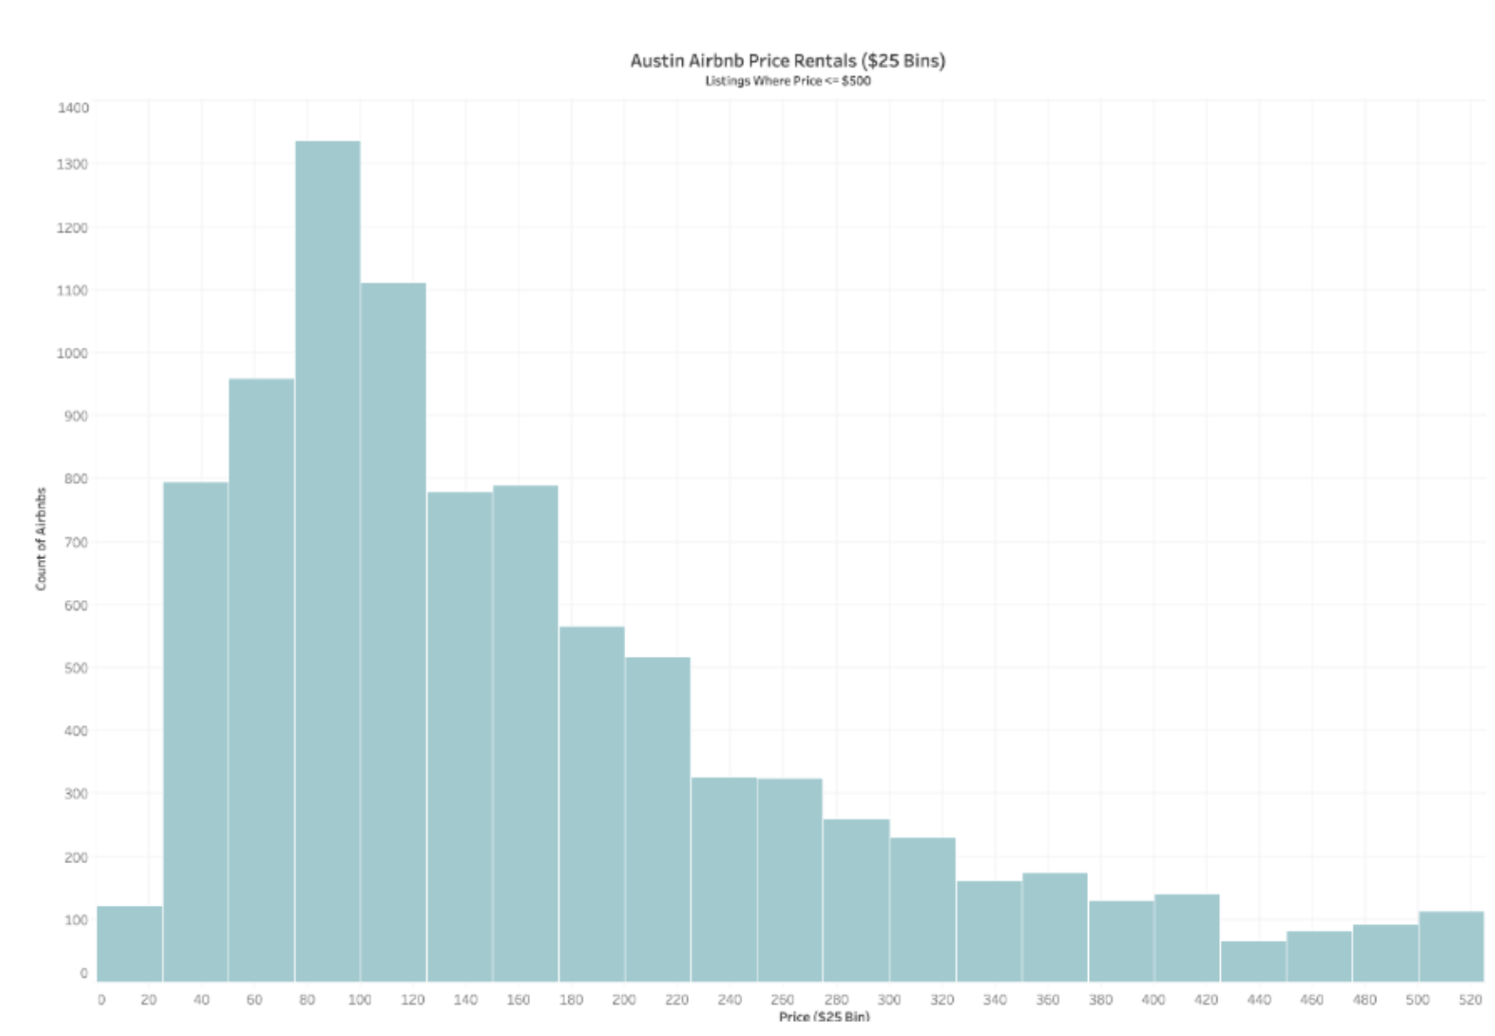
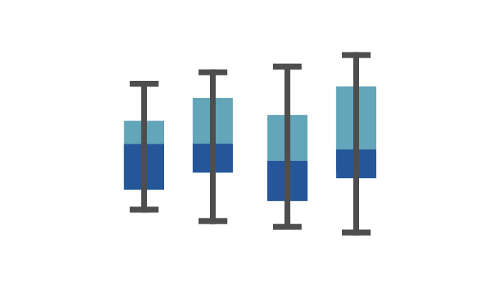
Chart Types – Distribution
Histogram Chart
1 Measure
Bins/grouping
Box and Whisker Chart
0 to more categories/variables
1 or more measure(s)

Slide 30
Histograms Chart - splits a single continuous measure into bins, or groups, to analyze distribution.
You should use a histogram if:
There is one continuous, numerical value that can be split into multiple bins
You are looking to understand the distribution of values within a single category
Examples:
measure a score or survey results
analyzing population data (Ex. age, sex, ethnicity)
find the average and determine if the process itself needs improvement
Avoid using a histogram if:
You need to analyze multiple dimensions simultaneously
Your data set isn’t scaled correctly
You want to compare the specific values of individual data points
Notes:
Histogram
Histograms split a single continuous measure into bins, or groups, to analyze distribution.
Histograms are a specific variation of bar charts, and provide a way to show distributions of data.
Unlike bar charts, histograms do not support comparisons between two or more categories.
These charts make it easy to analyze distribution of the numbers, and the largest frequencies.
They make it easy to perform statistical analysis, especially when it comes to analyzing population data (Ex. age, sex, ethnicity).
Bins are measured by the number of occurrences within each range of values.
This count will alter the appearance of the view depending on where the values from the data are concentrated.
When the values are concentrated on one side or the other of the middle it is called skew. O
the ways the data could display are called:
Bimodal distribution - which has two peaks
Plateau Distribution - which rises to a certain level and stays there for most of the bins
Edge Peak Distribution - which looks like a normal frequency distribution, except one bin at the end is higher than the rest, serving as a sort of tail
The x-axis used on a histogram functions as the width of the bars, while the y-axis functions as the height. Unless a particular category has no frequency at all, there should be no spaces between bars.
There are two primary ways of displaying data in a histogram: Count of values within bins, and Density of values (% of Total).

Slide 31
Histogram Chart - needs a continuous value and an axis starting at zero to properly display the count of values within each bin.
This histogram looks at Airbnb rentals in Austin, Texas
Showing price per day in $25 bins
The chart has a right-skewed distribution, and the average price for an Airbnb seems to be between $50 and $150 a night.
This histogram uses only one color
It looks at one measure
It has an easily estimated average
Notes:
Histograms split a single continuous measure into bins, or groups, that represent a specific range of values.
Data points are then grouped into these equally sized bins.
The bins are then displayed visually as bars stacked next to each other.
x-axis used on a histogram functions as the width of the bars, while the y-axis functions as the height.
Unless a particular category has no frequency at all, there should be no spaces between bars.
There are two primary ways of displaying data in a histogram: Count of values within bins, and Density of values (% of Total).
Example To measure the scores of Olympic divers, one bin could contain scores between 2 and 4, the next between 4 and 6 and another the scores between 6 and 8.
For data sets that impact customers, consumers, or clients, histograms can be used to measure satisfaction.
Some customers may feel their needs aren’t being met and might score the process with a low number, while others score it with a high number.
A histogram can help you find the average and determine if the process itself needs improvement.
You should use a histogram if:
You would like to explore how members within a category in a dataset are distributed. i.e. The breakdown of salaries within an organization with the ability to see how balanced your pay scale is, or the count of bank members that have X amount of dollars in their accounts

Slide 32
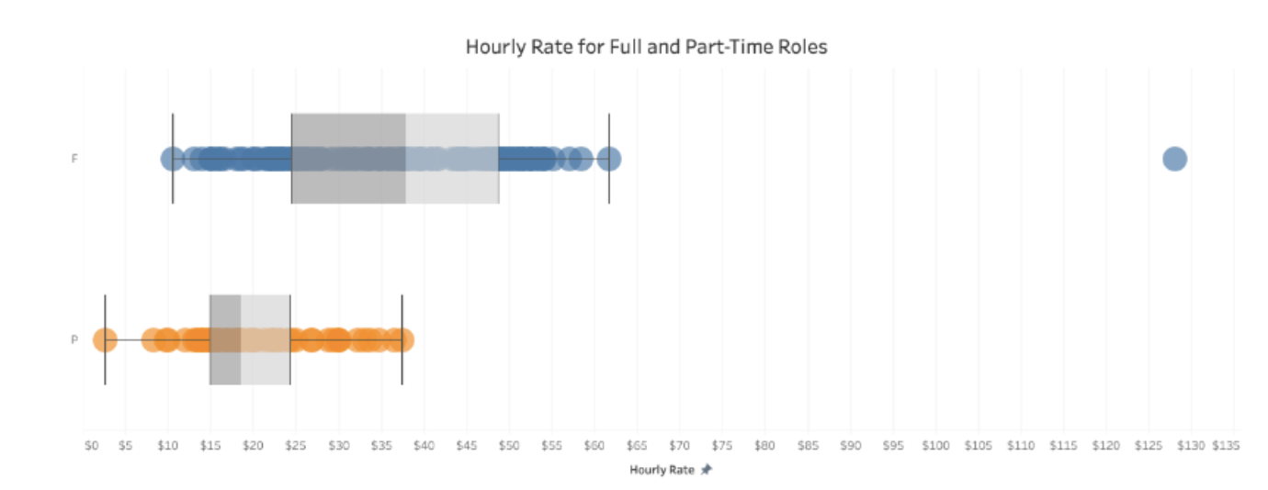
Box & Whiskers Chart – shows the range of values along with the median and interquartile ranges.
When to use:
To understand the distribution of data points within a range of values
To help determine the existence of outliers within the dataset
When you have a more granular qualitative value to partition your categorical field by
Do not use a box and whisker plot if:
You only have a limited number of data points
The measurements are all the same, or too close to the same
This box and whisker plot shows salaries for part-time roles and full-time roles are analyzed.
Two plots show the average for each kind of job
Applicants might be able to learn what to expect for a certain kind of job, and analysts can quickly determine which job titles are outliers
The measures use consistent colors
There is clearly a 25th percentile, a median, and a 75th percentile
Notes:
How to read Box and Whisker Plots
Box and whisker plots portray the distribution of your data, outliers, and the median.
The box within the chart displays where around 50 percent of the data points fall.
It summarizes a data set in five marks.
The mark with the greatest value is called the maximum.
It will likely fall far outside the box.
The mark with the lowest value is called the minimum.
It will likely fall outside the box on the opposite side as the maximum.
The box itself contains the lower quartile, the upper quartile, and the median in the center.
The median is the value separating the higher half from the lower half of a data sample, a population, or a probability distribution.
You can think of the median as "the middle" value in a set of numbers based on a count of your values rather than the middle based on numeric value.
These sections help the viewer see where the median falls within the distribution.
The lower quartile is the 25th percentile, while the upper quartile is the 75th percentile.
The median is the middle, but it helps give a better sense of what to expect from these measurements.
The whiskers (the lines extending from the box on both sides) typically extend to 1.5* the Interquartile Range (the box) to set a boundary beyond which would be considered outliers.

Slide 33
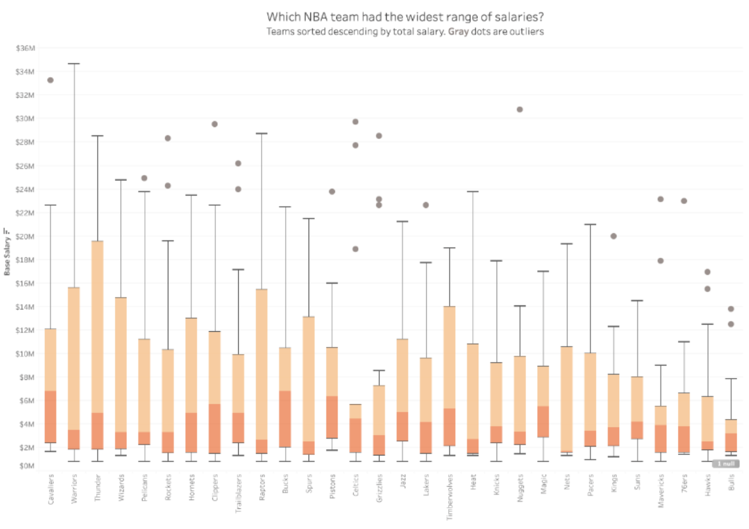
Box & Whiskers Chart - shows the distribution of data within a population.
This example shows the distribution of NBA salaries in 2017.
It's broken down by team to see which one has the widest range of salaries. It also shows which teams have a large amount of outliers
As shown above, one can arrange several box and whisker plots horizontally or vertically to allow for easy comparison
Notes:
They allow for users to determine where the majority of the points land at a glance.
They are even more useful when comparing distributions between members of a category in your data.

Slide 34
Types of Data Visualizations
Charts
Graphs
Tables
Maps
Dashboards

Slide 35
Tables
Easy to identify measures across a set of intervals (Ex. what was the company’s profit in November 2018)
Easy to identify measures across a set of dimensions (Ex. How many sales did each person close in 2019)
Column = qualitative variables/ categories
Rows = quantitative variables
Best used for :
Comparative data analysis on categorical objects
To show ranking
To compare data such as age, income range, locations etc.
Avoid using tables as your visualization if:
Trying to show trends
Analysis with a lot of variables or points
Notes:
TWhat is a Table? How Do I Use It?
Like most charts, a table organizes data by axis. The rows are the x-axis and columns are the y-axis. Common convention, because tables are read, uses the x-axis to display the categories. The y-axis displays the values within each measure, with the columns being labeled to clearly indicate their meaning. Unlike most charts, tables can display qualitative data in an organized manner and highlight relationships between them.

Slide 36
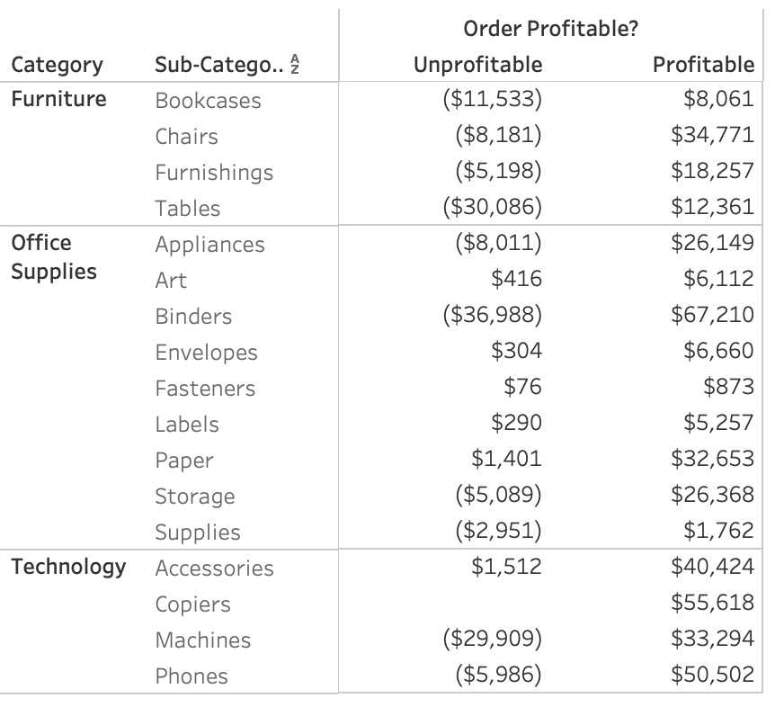
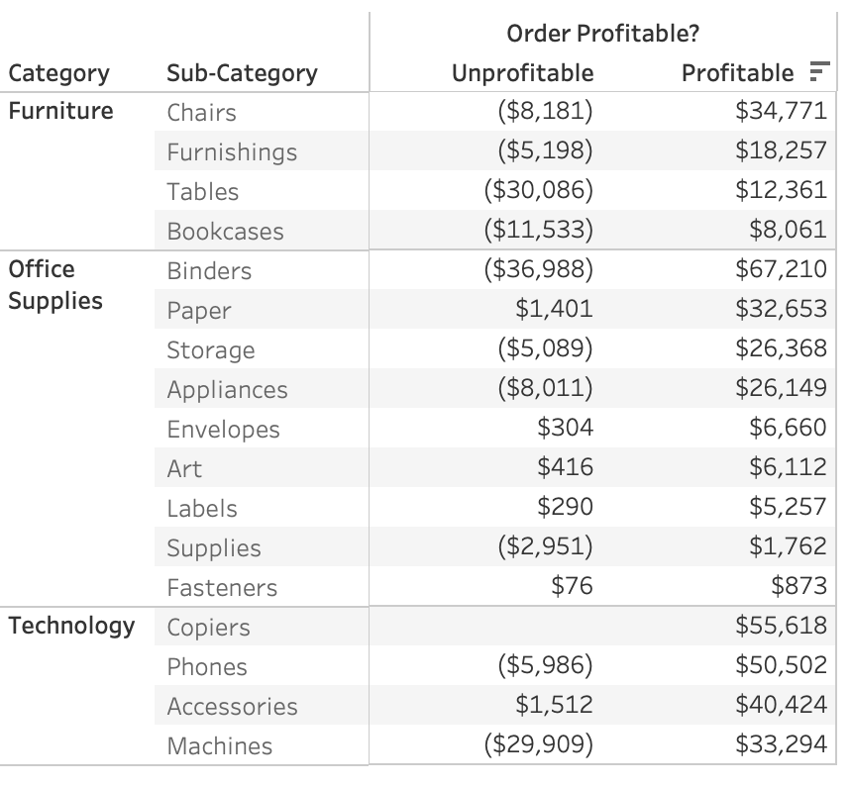
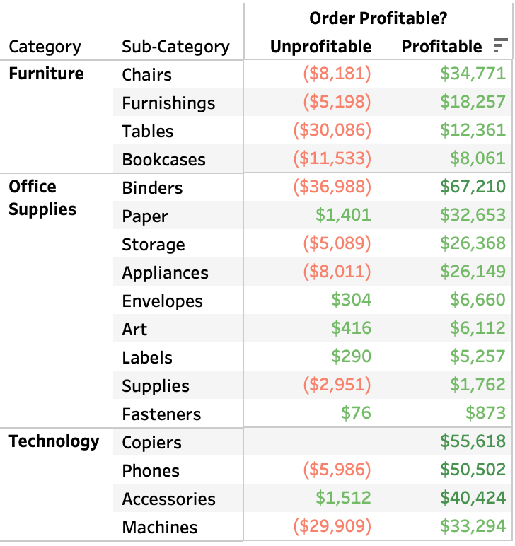
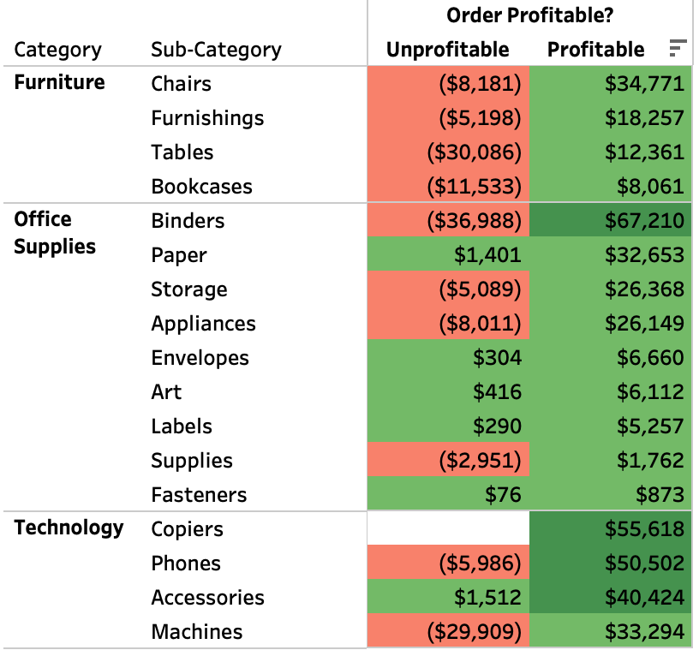
Tables
Better Example
Poor Example
The gray colored row help with following the row
Items are sorted from greatest to least profitable
Clear visibility of titles
Color also helps with what is good and bad
Hard to read across the rows
Numbers are not sorted
Column name is cut off

Slide 37
Types of Data Visualizations
Charts
Graphs
Tables
Maps
Dashboards

Slide 38
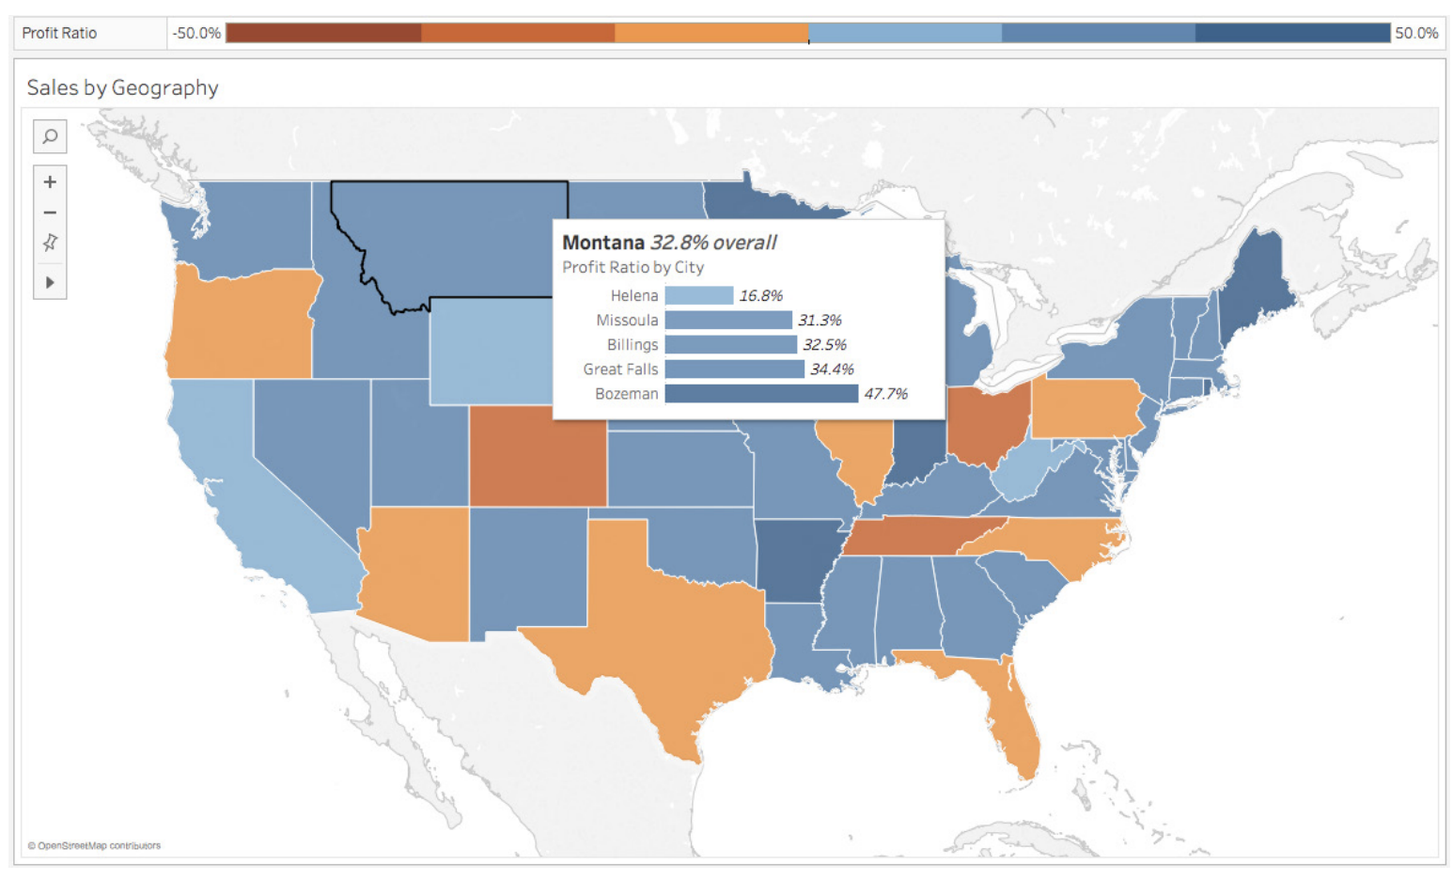
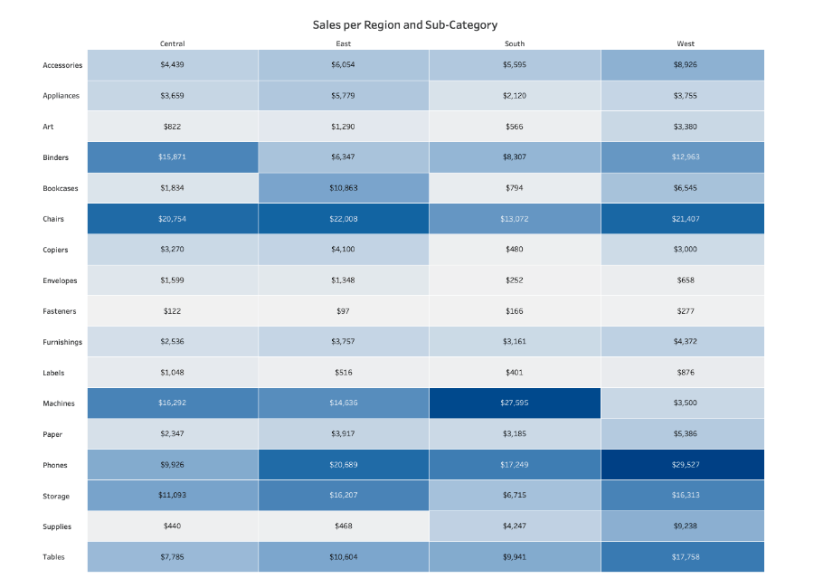
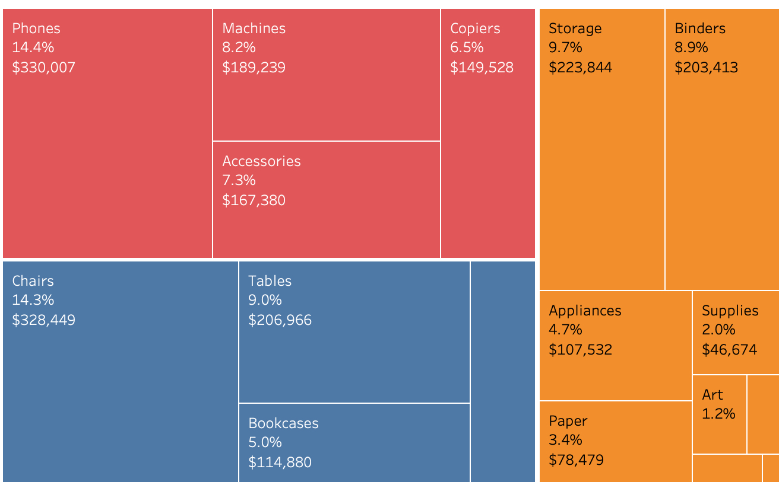
Maps
Map
1 geographic variable
O or more category/variable(s)
0 or 2 measure(s)
Heat Map
1 or more category/variable(s)
1 or 2 measure(s)
Treemap
1 or more category/variable(s)
1 or 2 measure(s)

Slide 39
Map - used for visualizing any kind of location information (postal codes, state abbreviations, country names).
Simple and compelling way to show how location correlates with trends in your data
Example : Insurance claims by state, product export destinations by country, car accidents by zip code, and custom sales territories
A map provides an intuitive way to drill down into your data
Viewers can see large trends at a glance, and use filter actions to quickly investigate even further
Tips:
Use a map as a filter for other types of charts, graphs, and tables
Layer data points on top of maps
Marks can be overlaid on a map to show individual data points with more precision
Try varying their size to add more visual detail to your analysis

Slide 40
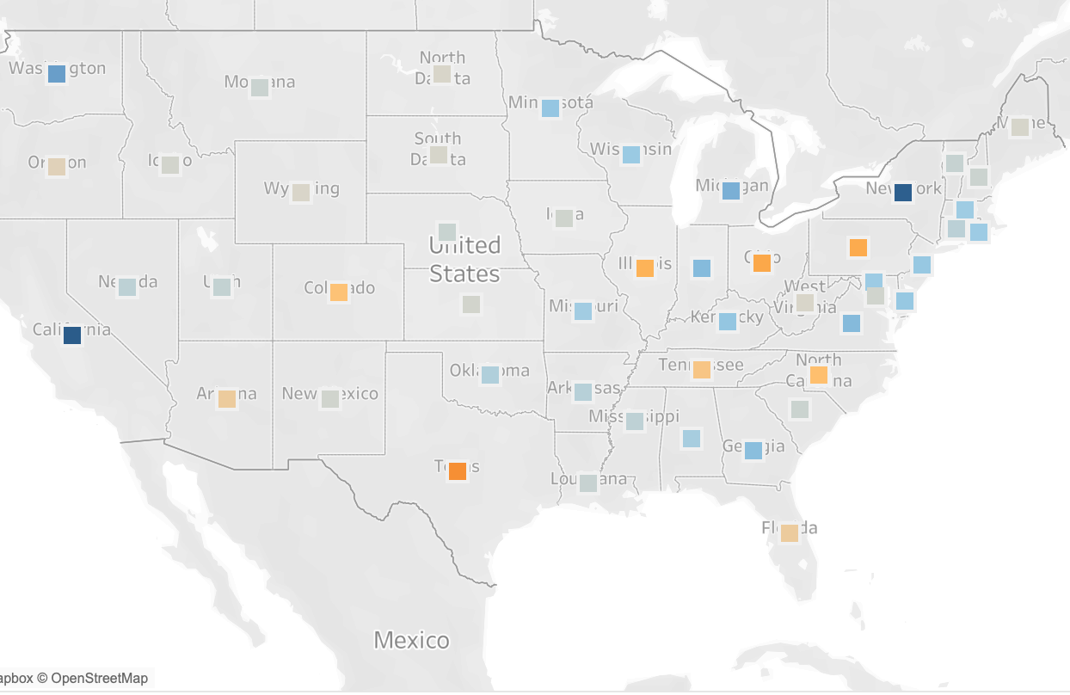
Maps - This map shows profit ratio by state.
Poor Example
Better Example
Hard to see the color representation
Not very informative without a scale
Tooltip shows city level info without leaving the view
Compare states by color
scale to identify meaning of the color
Notes:
By layering in a tooltip, you can dig into the city level without leaving the view. In this case, we see that Montana has a 32.8% profit ratio overall, which we can visually compare to other states through the use of color.

Slide 41
Treemap - represents part to whole relationships.
Provides an accessible way for viewers to interpret their data at a glance
Functions as a visualization composed of nested rectangles
represent certain categories within a selected dimension and are ordered in a hierarchy
Quantities and patterns can be compared and displayed in a limited chart space
A good treemap will have:
Distinct numerical values
A distinct hierarchy
No more than three or four labeled tiles
An obvious highest level of the hierarchy
Not display negative values
A poor treemap will:
Look cluttered with too many categories and labels
Have too many similar values

Slide 42
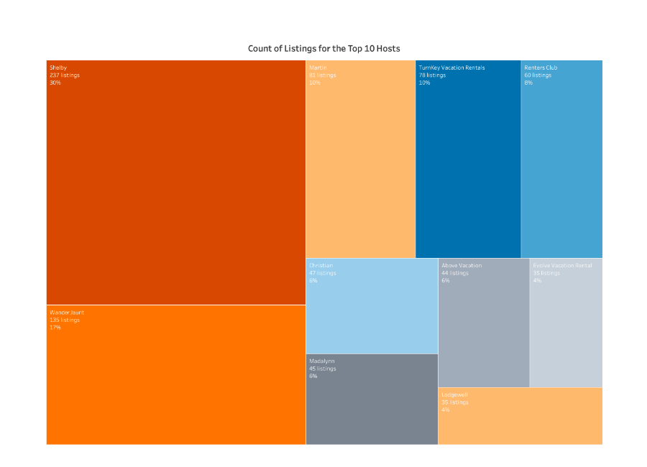
Treemap - Color can represent dimensions such as categories.
Poor Example
Better Example
Measures a few categories in relation to each other
Borders indicate that all three categories' measures make up a whole
The colors are distinct from each other
Map is confusing and difficult to read
The same color is used for multiple categories
Many of the boxes look similar in size and measure
Notes:
How do I read a Tree Map?
(Color can represent dimensions such as categories) or measures (such as KPIs). If used to represent a KPI, a darker color may highlight extremes, high or low.
For dimensions, a user might use a categorical palette, assigning a different color for each available shipping mode.
For measures, a continuous color palette would show a company’s sales numbers or profit.
When analyzing a tree map for insights, the largest box shows the largest part of the whole, while the smallest box shows the smallest part.
For a deeper analysis, These boxes can be nested to show many categories. For example, a box within the “office expenses” data set might display “percentage spent on furniture.” A box nested within that box might display “percentage spent on desks.”
What type of analysis does a tree map support?
Treemaps best depict data that needs to show a part-to-whole relationship.
Percentages of a measure for each dimension are displayed as squares that, when added together, comprise the whole.
Using our Superstore dataset, we can divide the total number of sales into categories. Adding the Product Sub-Category dimension would create “seating,” “tables,” and “lamps”. In this example, three specific items of furniture that fall under their respective categories become smaller nested squares.

Slide 43
Heatmap - uses color and size to show the values of a measure.
Present patterns, trends, and relationships within the data
Work best for presenting trends in dimensions that have more variables
Use both color and size to show what’s going on
This allows you to encode two measures: one for color and another for size
Bad heatmaps will have:
Too many similar sizes across shapes
The size and the color represent two different measures
Not a strong enough distinction between big and small numbers
Unreadable text
Notes:
Heatmaps present patterns, trends, and relationships within the data.
They use color and size from two on the same or different measures.
For example, while using color to help identify changes to a measure in a heatmap, the creator might reinforce its importance by keying the same measure to size.
To identify trends you’ll want to ask yourself: where is my point of interest in relation to the lightest, palest color on the heatmap? Is there an increase in the size of the shape used at a certain time or place in the map? The answers to these questions could indicate a relationship or trend forming within the data.
Heatmaps work best for presenting trends in dimensions that have more variables.
Example
A hospital can have many patients come in and out at the same time. The hospital may want to know whether these patients are scheduled or are emergency visits?
A heatmap can make that distinction with unique rows or columns for each type of appointment.
They can show hospital peak hours, and patient volume with color and size

Slide 44
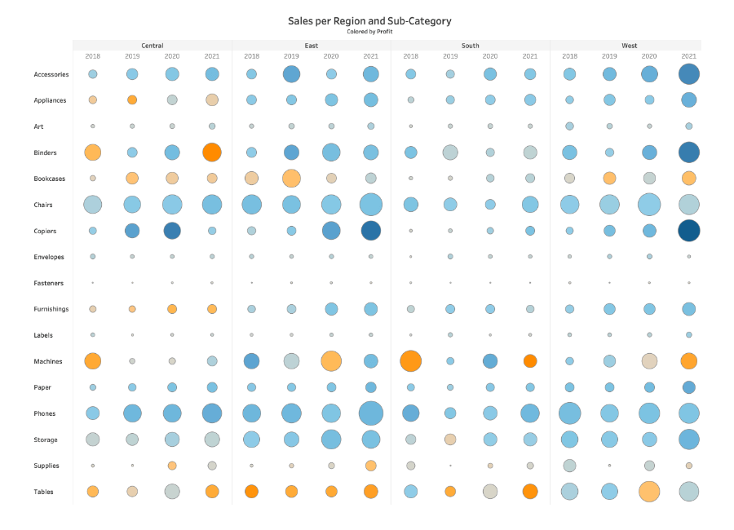
Heatmap
Poor Example
Better Example
Splits those four regions into four years per region
Difficult to compare the same Sub-Category across Regions for the same year
Relies on legends to know what mark color and size means which make it difficult to understand
Easy to compare subcategories for each Year/Region combination
Only one shape making it easier for our eyes to compare across space (square)
The title is a discerption making it easier to identify what the encoding of size and color mean in the view
Notes:
Because a heatmap is still the best solution for this much information, we will keep the chart type but will reorganize fields to make it easy to compare subcategories for each Year/Region combination.
We’ll also change the shape to one that is easier for our eyes to compare across space (square).
Last, we will put descriptors in the title making it easier to identify what the encoding of size and color mean in the view. Here is the proposed alternative:

Slide 45
Types of Data Visualizations
Charts
Graphs
Tables
Maps
Dashboards

Slide 46
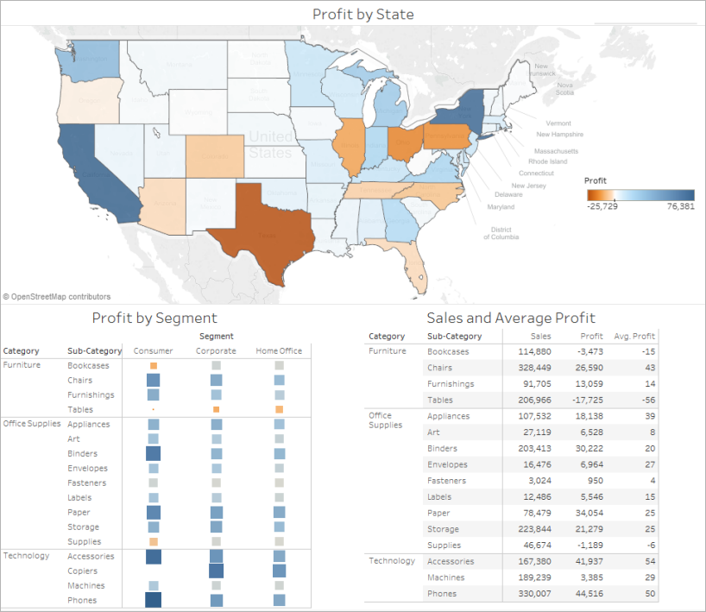
Dashboards - collection of several views, letting you compare a variety of data all at once.
Can align your organization's efforts, help uncover key insights, and speed up decision-making
Tips for a good dashboard:
Know your audience
Put your most valuable data point there
Provide guidance or instructions of how to get started
Don’t put too much information, you can always create additional dashboards
Stick with two or three main views and only use colors when meaningful
Use tooltips to add more context or information without taking up space
Notes:
Know your audience
Ask yourself: who am I designing this for, why do they need it, and what is their level of understanding with the subject matter and data?
Use the sweet spot
Most people instinctively start scanning a screen in the upper left-hand corner. Put your most valuable data point there.
Give direction
Don't assume your audience knows where to start interacting with your dashboard. Provide guidance or instructions of how to get started.
One dashboard does not tell all
Trying to cover every business challenge with one dashboard can result in information overload for viewers. Remember: you can always create additional dashboards.
Limit views & colors
Stick with two or three main views and only use colors when meaningful. Too many views and colors can create visual overload and get in the way of analysis.
Format tooltips
Tooltips can add great context or information for the viewer without taking up any precious real estate. Using tooltips helps to build interactivity and reinforce your data’s story. For example, when you hover over a mark, you get information just about that mark.

Slide 47
Additional Data Visualization Tips
NEVER complicate the visual display
Stay away from any kind of 3-D charts or graphs
Distracting the chart with unnecessary graphics or logos
If there is a comparison to be made between multiple categories, consider the chart type you are using (line chart works best)
Always add labels and titles when needed to understand a context

Slide 48
Practice Tableau
https://help.tableau.com/current/guides/get-started-tutorial/en-us/get-started-tutorial-home.htm
Notes:
Homework

Slide 49
Resources
Free Training Videos
https://www.tableau.com/learn/training/20202?qt-training_tabs=1#qt-training_tabs
Tableau Starter Kit
https://www.tableau.com/learn/starter-kits
Build a workbook
https://help.tableau.com/current/pro/desktop/en-us/getstarted_buildmanual_ex1basic.htm
Preparing Excel Files for Tableau
https://help.tableau.com/current/pro/desktop/en-us/data_tips.htm
Visualization guide
https://www.tableau.com/learn/articles/data-visualization
Which chart or graph is right for you?
https://www.tableau.com/sites/default/files/whitepapers/which_chart_or_graph_is_right_for_youwp_1.pdf
10 Best Practices for Building Effective Dashboards
https://www.tableau.com/sites/default/files/2021-09/10%20Best%20Practices%20for%20Building%20Effective%20DashboardsWP.pdf

